Slide 1
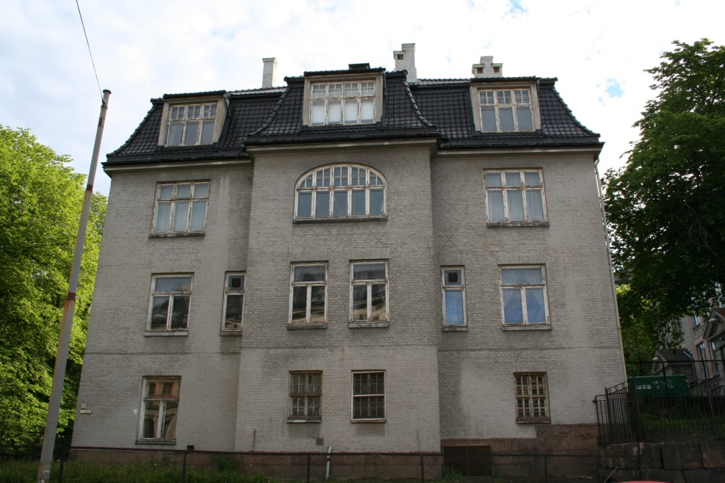
The Boy in the Striped Pyjamas
Mr. Coffey
Chapter 2 The New House

Slide 2
Learning objectives:
In this lesson we will:
Use and develop the skill of ‘skimming’ through a text for key information.
Draw comparisons between the two homes in Bruno’s life.
Examine the relationship between social classes.

Slide 3
First task
Read chapter 2.
You can also listen to the Audible version of the story.
Choose two out of the three written activities to answer!

Slide 4
Second task
excited
lonely
nervous
afraid
angry
intrigued
frustrated
unsafe
curious
happy
Choose three words from the list across that you would use to describe how Bruno felt in chapter two.
We are going to use PEE (Point, Evidence and Explain) for this activity. You need to use evidence from the chapter to validate the point you made. If you think Bruno was happy in this chapter, can you give evidence to back this up from the reading??
You can start like this (PEE):
When Bruno moved to his new house he felt ...
I know this because ... (quote)
This tells us that ...

Slide 5
Chapter 2
In this chapter, Bruno tells us about the new house he has moved in to and also about his old house in Berlin.
Draw a table like the one below and write all the words you can find for each house in the corresponding box.
House in Berlin | New house at ‘Out-With’

Slide 6
Discussion between Maria and Bruno
What impression do you get of both of their positions in society? Can you give evidence to support this?
Why does Bruno think it is okay to talk to Maria about these things, but is afraid that the other members of the family will hear?
How does the chapter end? What technique is the author using at the end of the chapter?

Slide 7
Go raibh míle maith agaibh ☺
Thank you ☺
https://www.youtube.com/watch?v=1G176FS0Nww&list=PLKwtZgvBM54WsDpIxmU2k498q87BK1HxQ&index=2

